Slide 1



Deep learning with Pytorch: Zero to Gans By Jovian ML
Summer Project 2020
Submitted By
Ritik Chawla
Enrolment no. – 05015602718
Student of
Dr. AKHILESH DAS GUPTA INSTITUTE OF TECHNOLOGY & MANAGEMENT
Affiliated to
GURU GOBIND SINGH INDRAPRASTHA UNIVERSITY

Slide 2


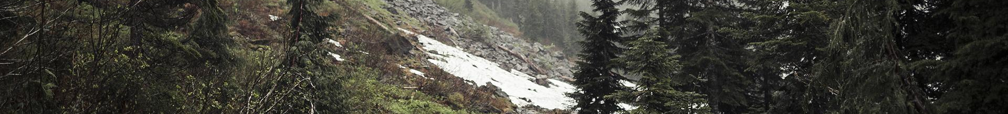


01
02
Jovian ML
FreecodeCamp
03
04
PyTorch
Kaggle
A platform for data scientists to track and reproduce machine learning experiments
Free Code Camp is an open source community that helps people learn to code.
PyTorch is a Python package that provides two high-level features:
Tensor computation (like NumPy) with strong GPU acceleration
Deep neural networks built on a tape-based autograd system
Kaggle, a subsidiary of Google LLC, is an online community of data scientists and machine learning practitioners.

Slide 3

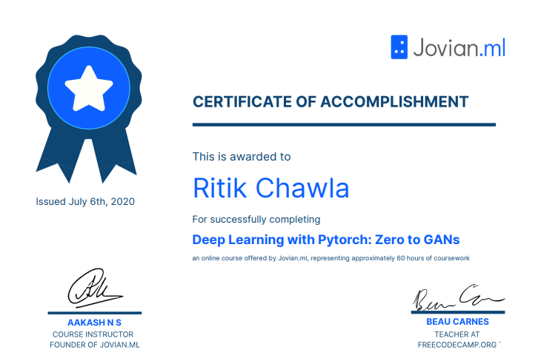
Certificate
Total 6 weeks course with 3 Assignment , a Kaggle Competition and a course Project
Certificate Link- https://jovian.ml/certificate/MFQWCMZSHA

Slide 4
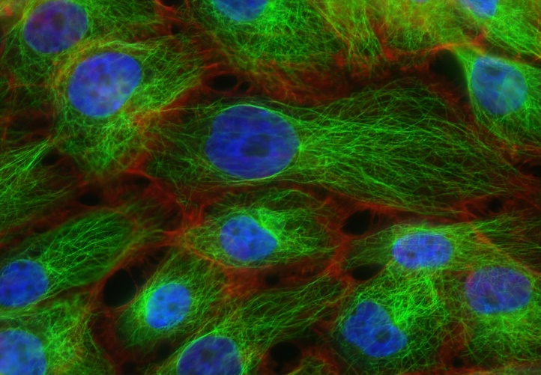
Introduction
MultiClass Human Protein Classification using PyTorch
The goal is to identify which proteins are in each image. The problem about multiclass is that there can exist multiple proteins in just one image as it can be seen on Figure 1. The dataset has over 19,000 images of proteins.

Slide 5
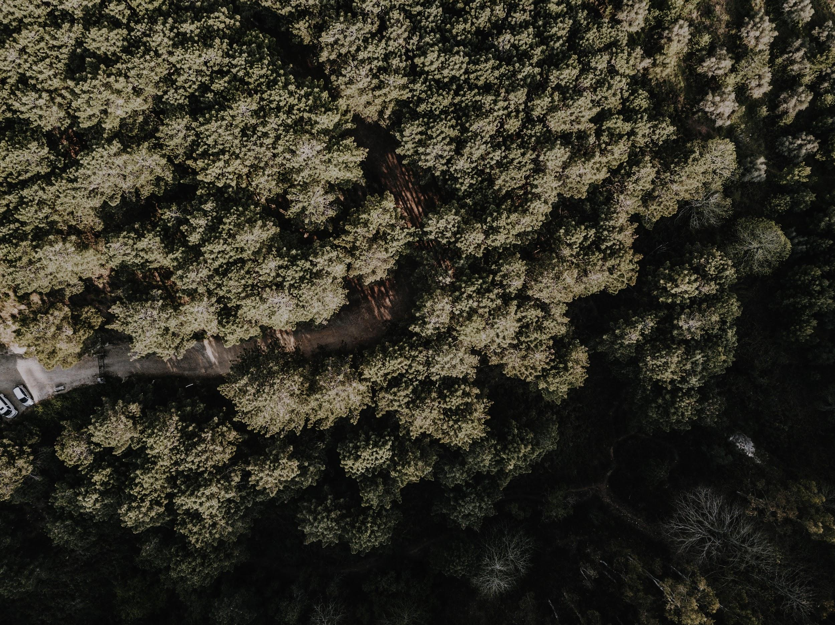
Quote
― Neal Stephenson
“Information contains an almost mystical power of free flow and self replication, just as water seeks it's own level or sparks fly upward.”

Slide 6
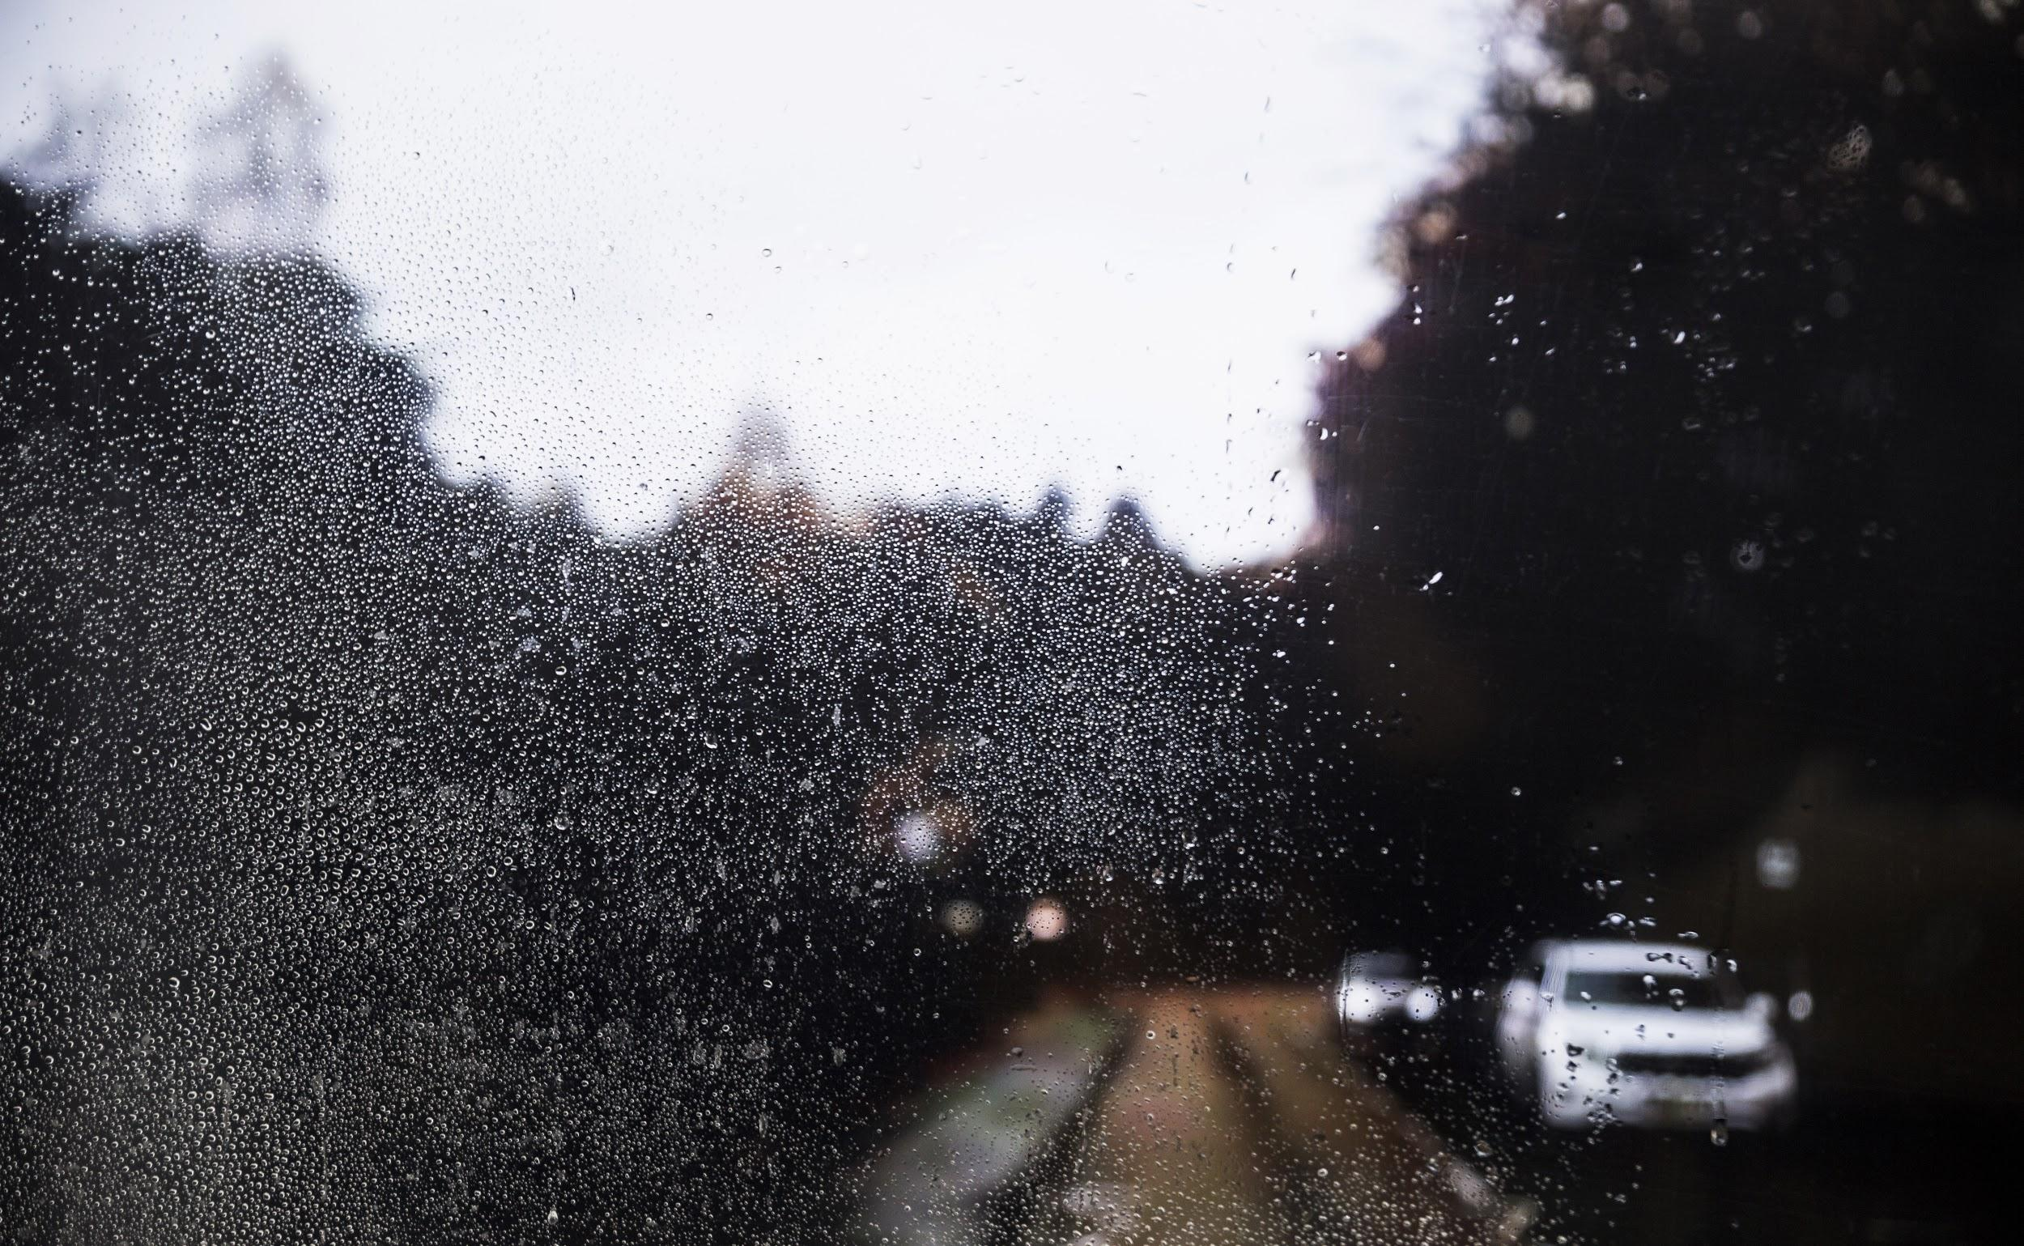
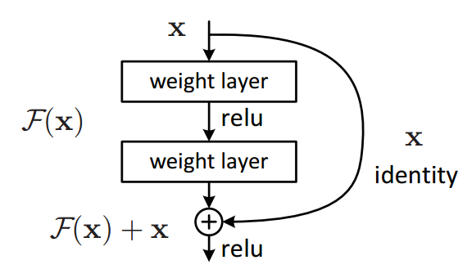
Study Objectives
Transfer Learning
Data normalization
Residual connections
is a research problem in machine learning that focuses on storing knowledge gained while solving one problem and applying it to a different but related problem.
normalized the image tensors by subtracting the mean and dividing by the standard deviation of pixels across each channel.
the addition of the resudial block, which adds the original input back to the output feature map obtained by passing the input through one or more convolutional layers.

Slide 7
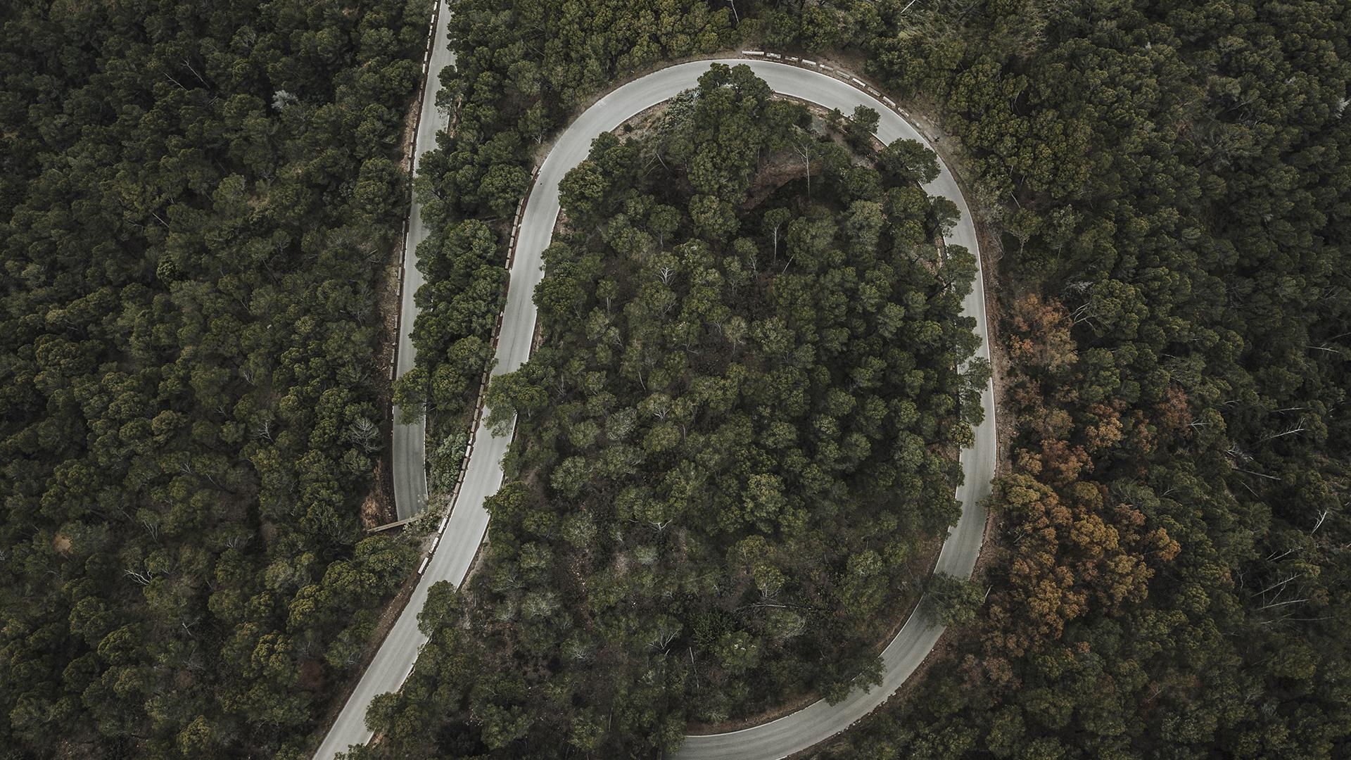
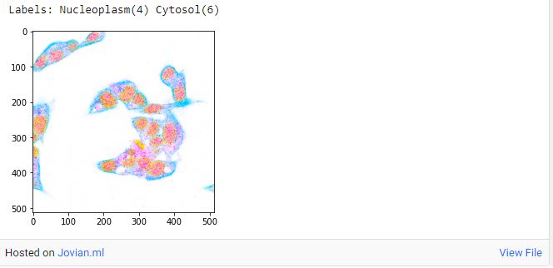
Exploratory Data Analysis
Theory 1
Theory 2
Most common proteins structures are the Nucleoplasm, with over 8,000 samples, and the Cytosol, with over 6,000 occurrences.
In contrast small components like the Nuclear bodies, Nuclear speckles, Nucleoli fibrillar center and Centrosome, are in few quantities in our dataset, not even reaching the 2000 samples. For these classes the prediction will be harder as we have less training examples that may not cover all variabilities and as our model will become more bias towards more numbered classes. Due to this, we will make less accurate predictions on the minor classes

Slide 8
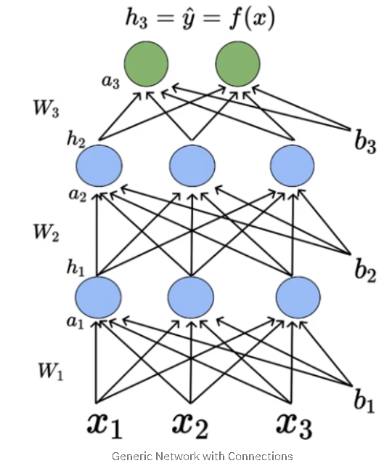
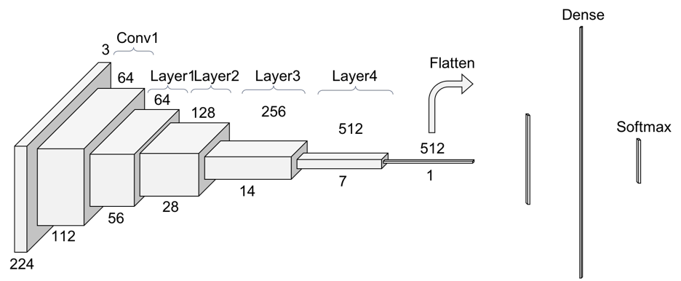
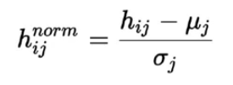
Methodology
Weight decay
BaseLine Model
Batch Normalization
Residual Blocks
prevents the weights from becoming too large by adding an additional term to the loss function
The ResNet34 network is a highly deep network, being famous for dealing with images extremely well.
Since we are computing the mean and standard deviation from a single batch as opposed to computing it from the entire data. Batch normalization is done individually at each hidden neuron in the network.
adds the original input back to the output feature map obtained by passing the input through one or more convolutional layers.

Slide 9
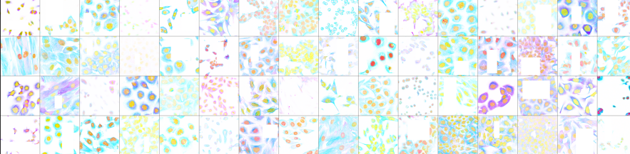
Code 9

Slide 10
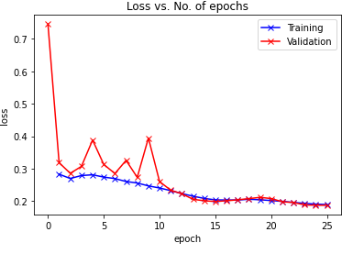
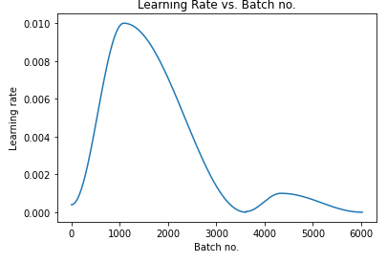
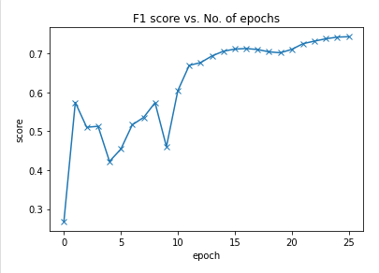
Results Analysis
Statistics
Gradient Clipping
Adam
the value is rescaled according to the maximum value provided
Adaptive moment estimation
Accuracy
Kaggle Test -Tuning hyperparameters as well as the data.
78%

Slide 11
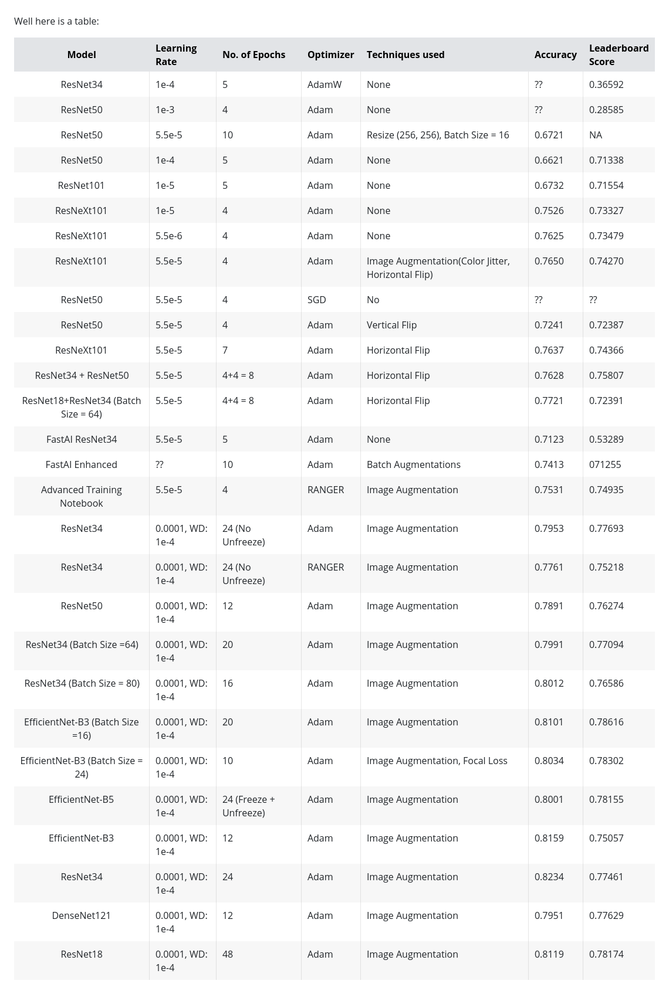
Table for Hyperparameters used

Slide 12
HyperParameters Table 2

Slide 13
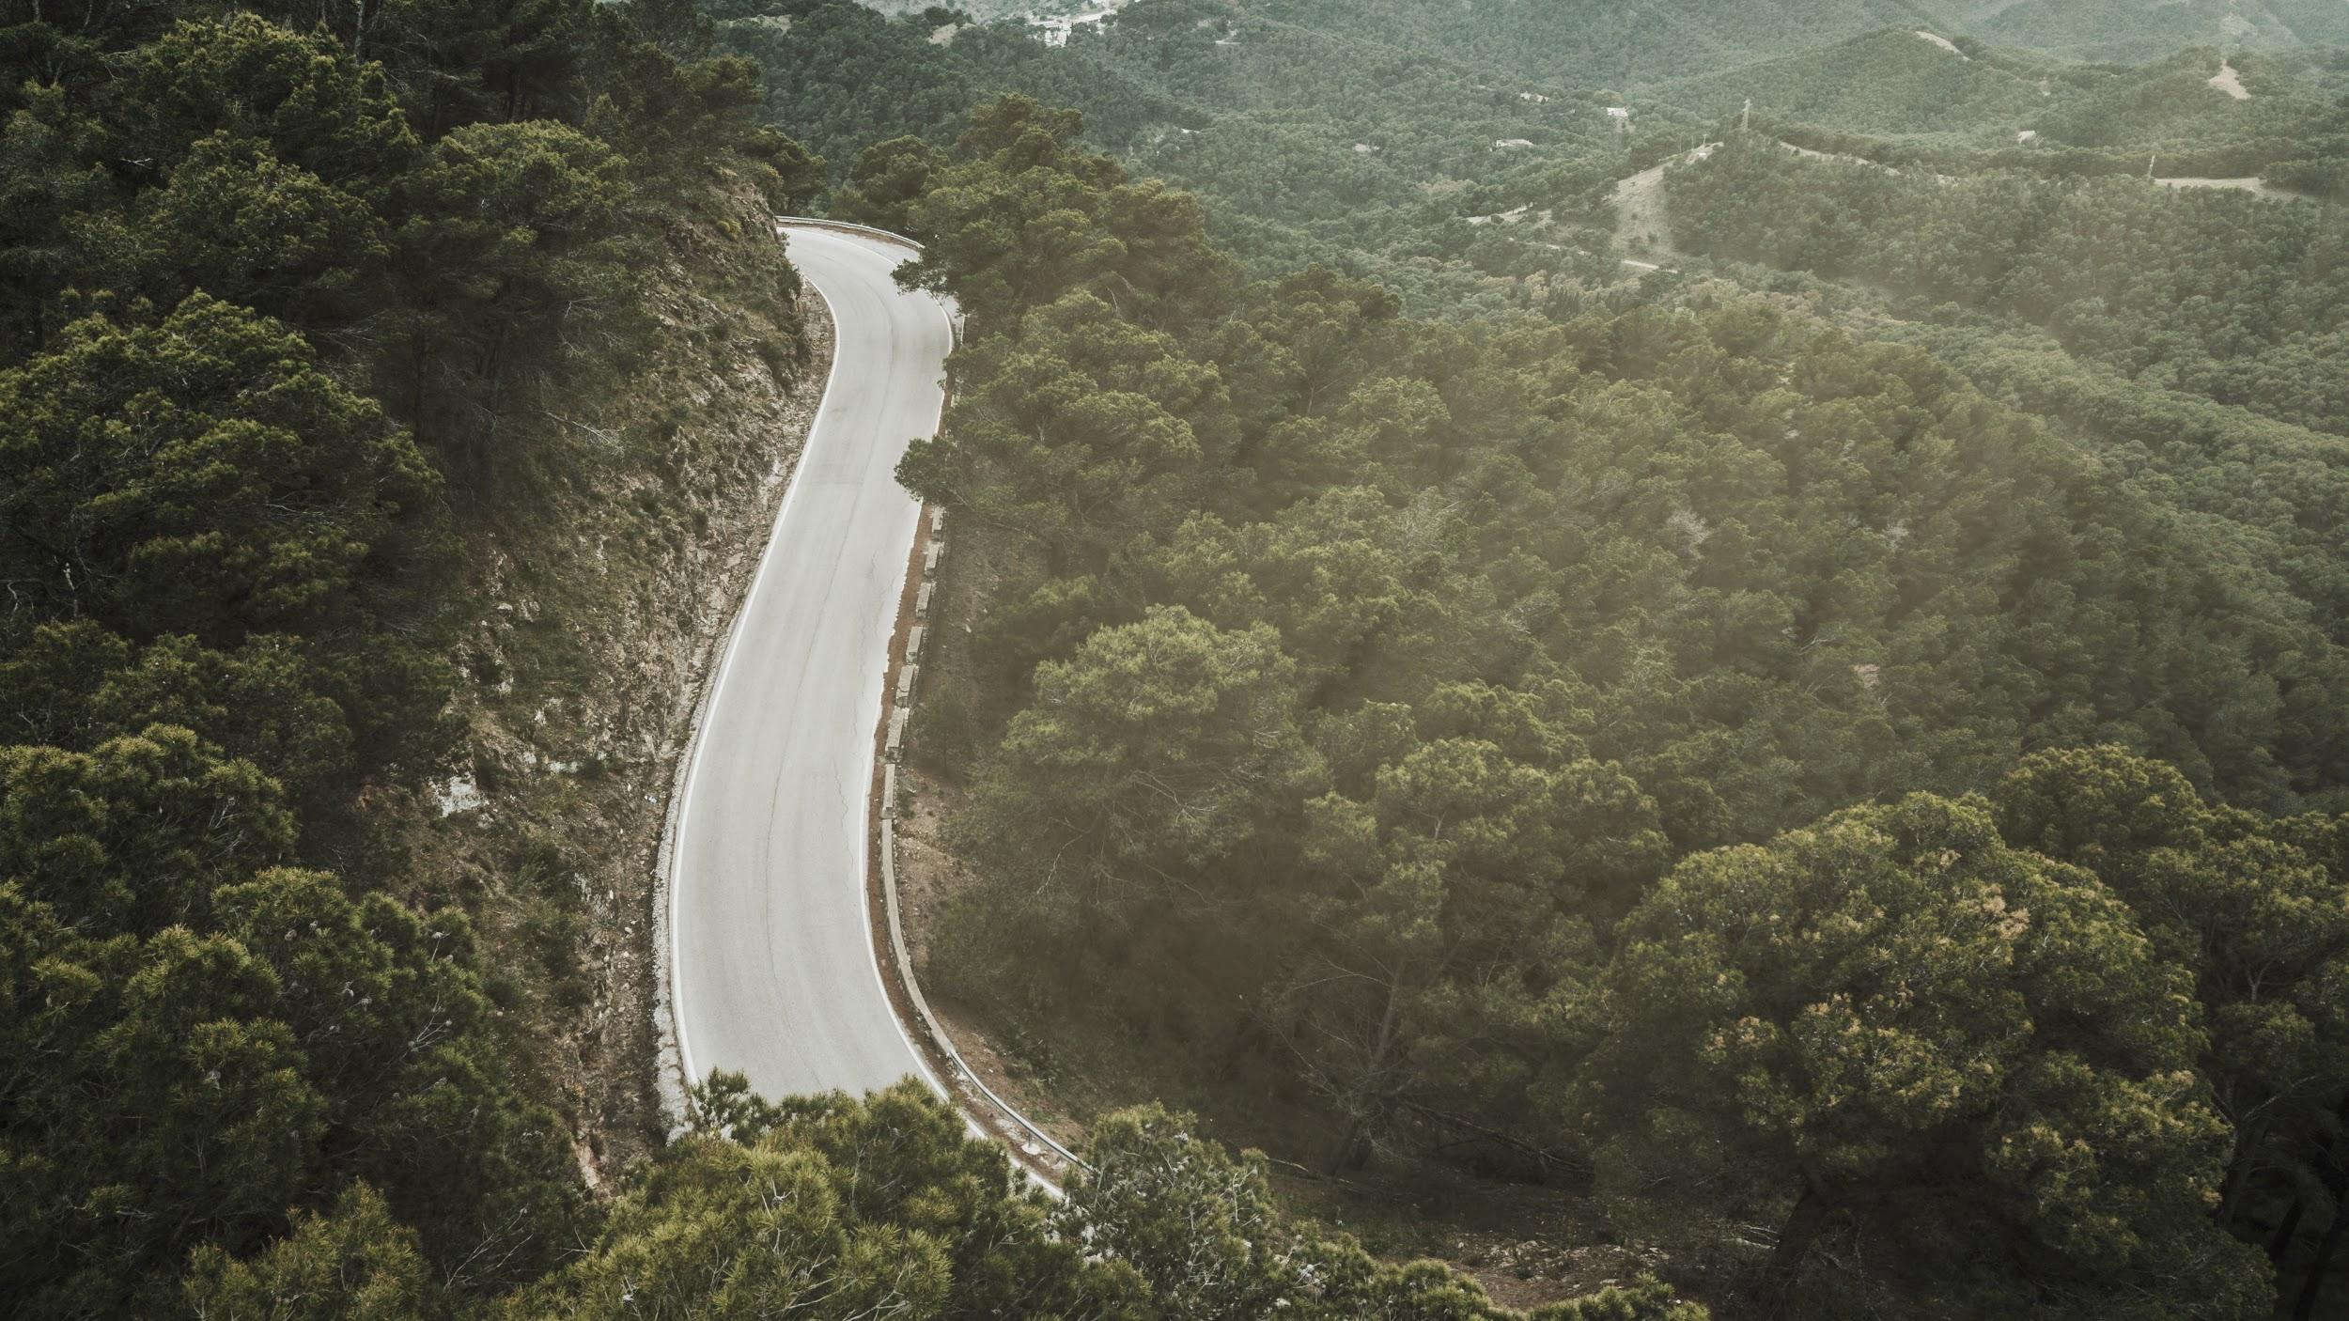
Thanks
Thanks
Project Report Included in The Project
ritikchawla2014@gmail.com
Profile: https://jovian.ml/ritikchawla
Email: ritikchawla2014@gmail.com

Slide 14
Bibliography
There are some negative correlations, meaning that some images, like the Nucleoplasm and the Nuclear speckles are unlikely to appear together. This is in fact true since Nuclear speckles are morphologically distinct of Nucleoplasm.
Used One Hot Encoding in the project https://scikit-learn.org/stable/modules/generated/sklearn.preprocessing.OneHotEncoder.html
Jovian Forums https://jovian.ml/forum/c/course-discussions/pytorch-zero-to-gans/18

Slide 15
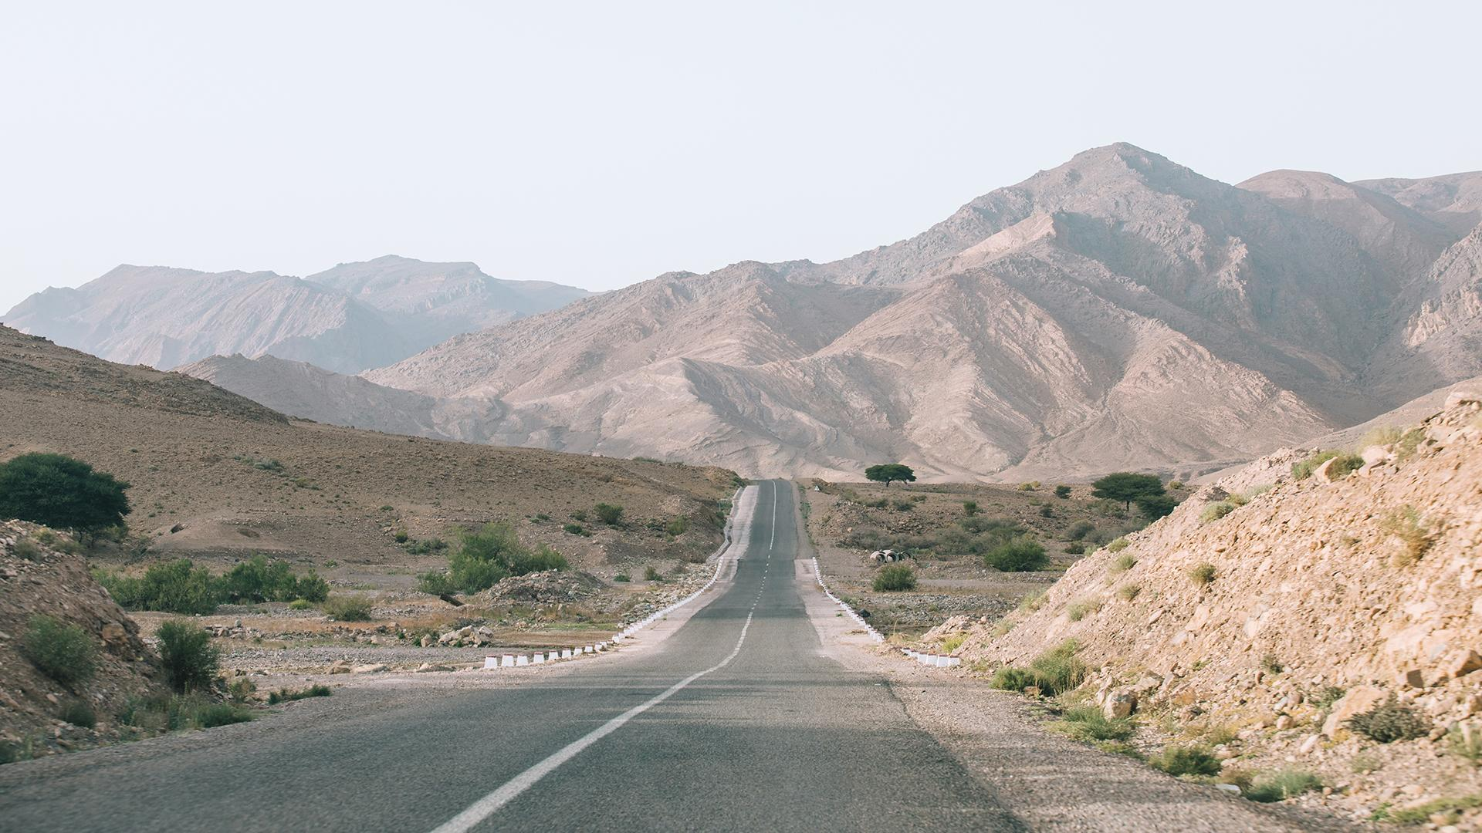
Credits
I would like to thank Jovian ML, FreecodeCamp and all my College Teachers for helping me learn and implement something useful.
Freecodecamp: https://www.youtube.com/channel/UC8butISFwT-Wl7EV0hUK0BQ
Slidesgo.com for Master's Thesis Blue variant template
3 Blue 1 Brown (Youtube) for presentation music and video

